Slide 1
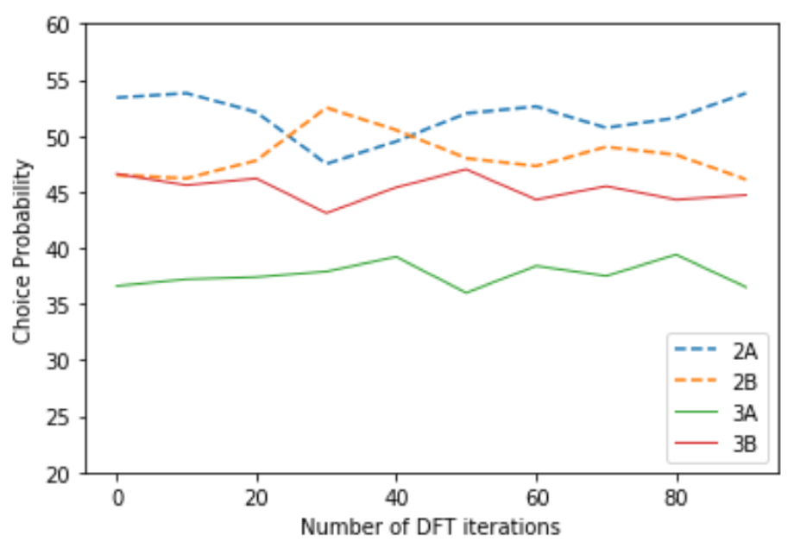
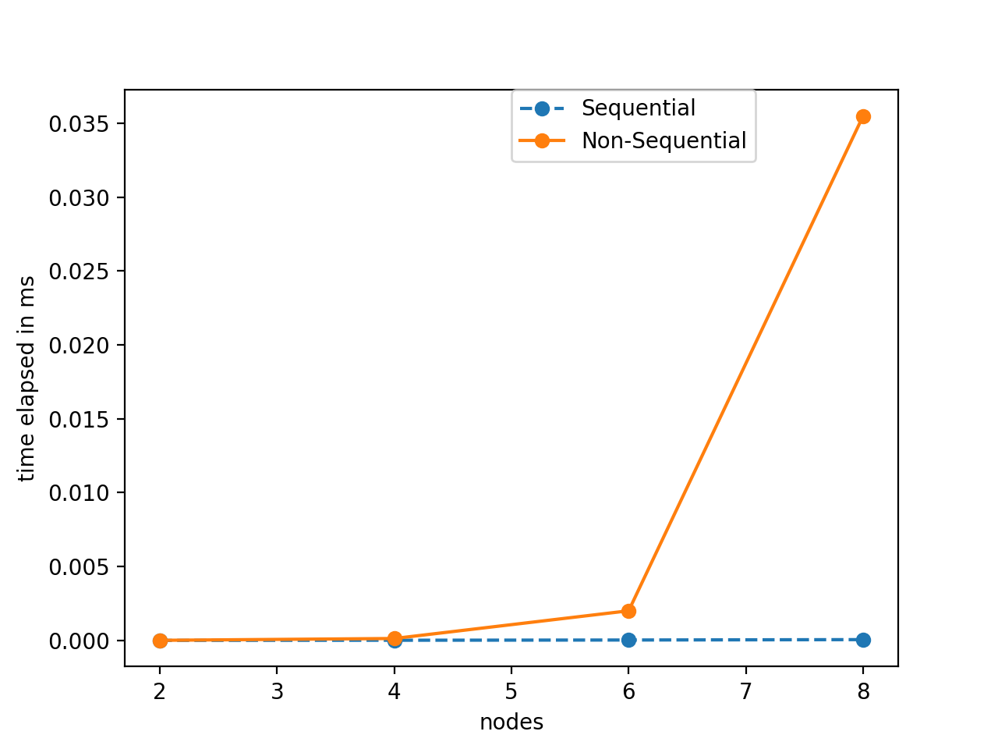
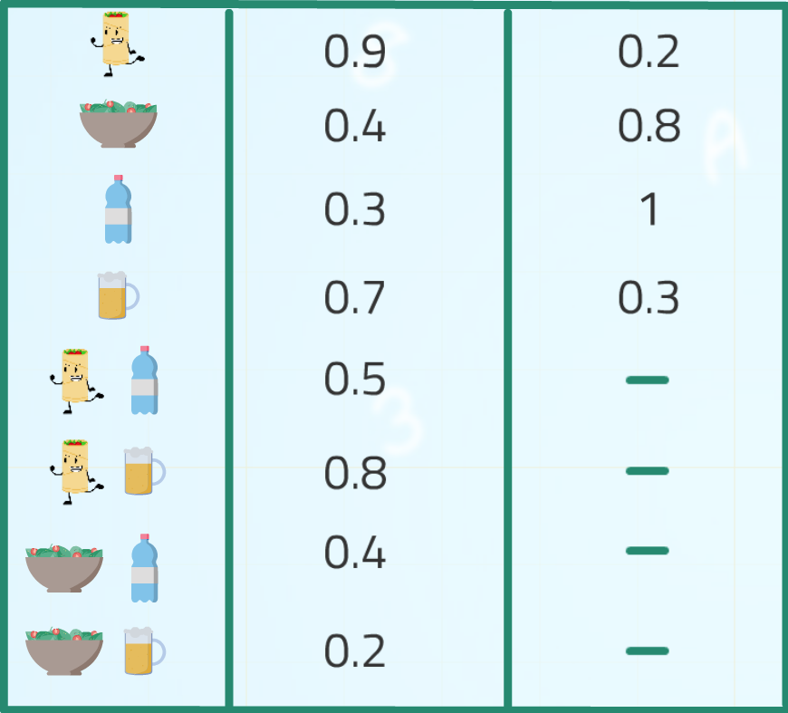
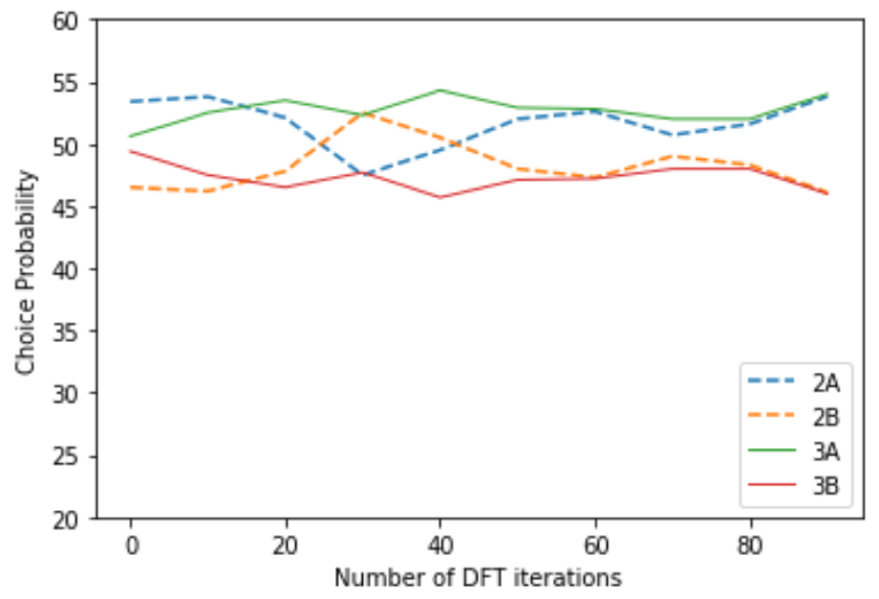


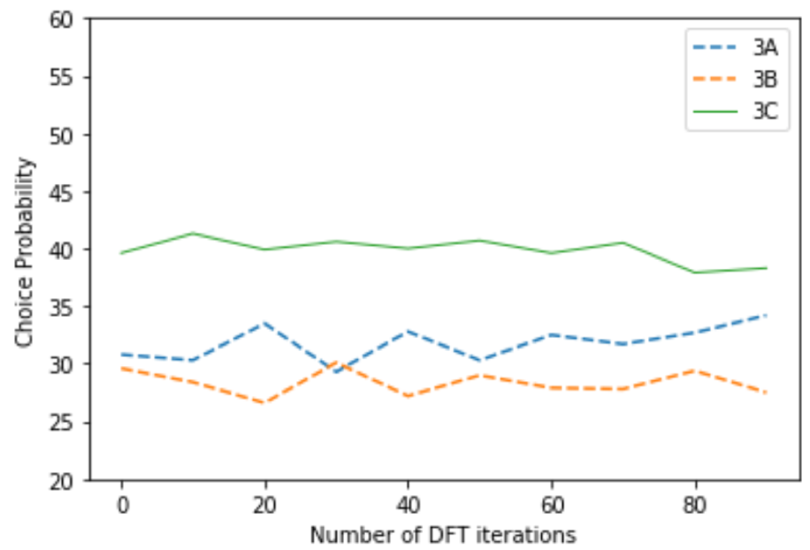

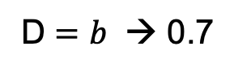
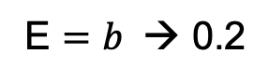

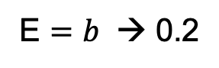
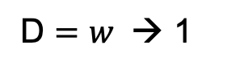
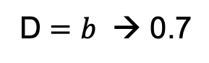
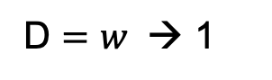

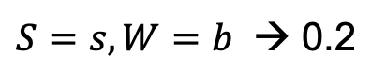

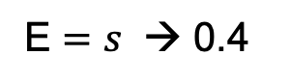
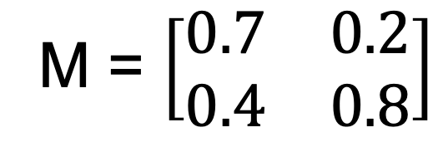
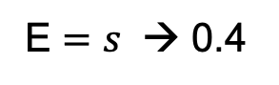
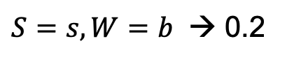
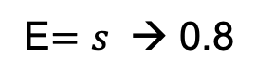

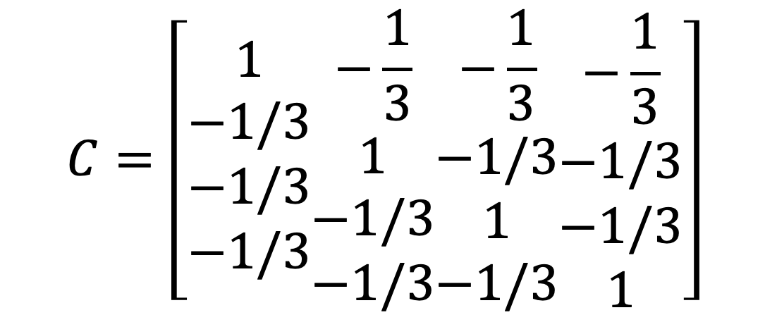
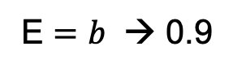
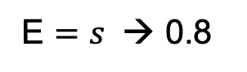
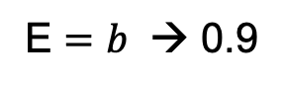

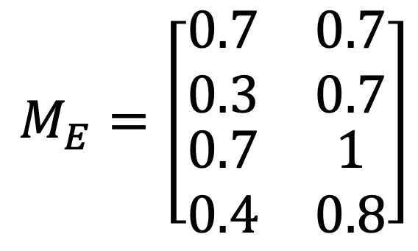
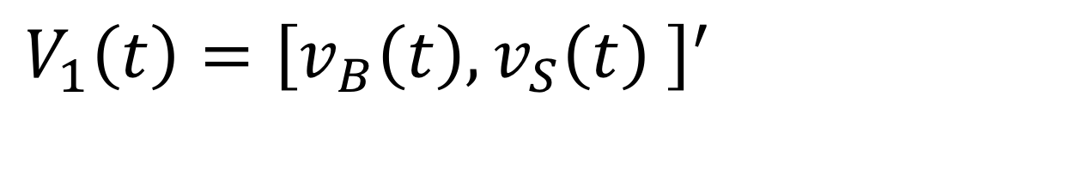
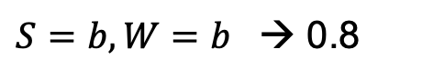
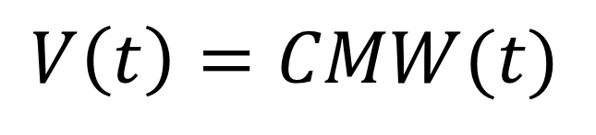
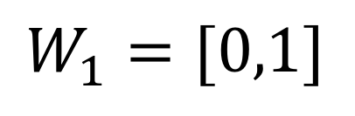
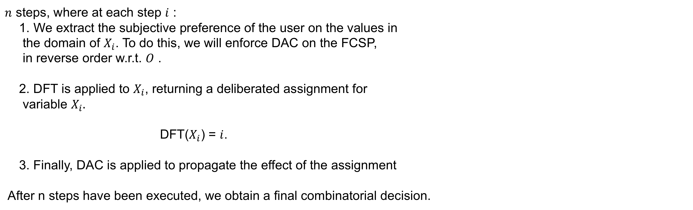
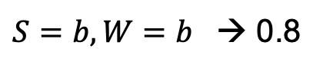
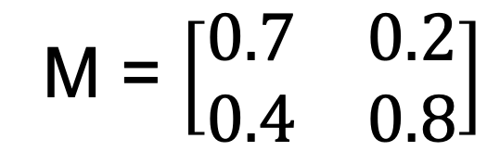

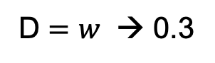
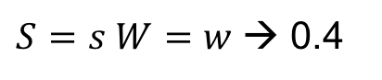
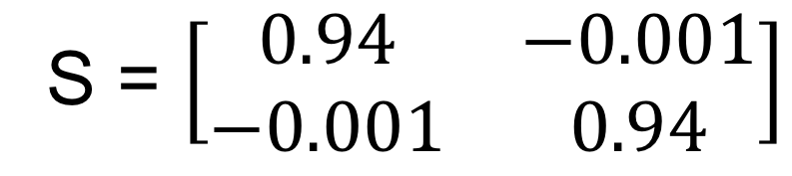
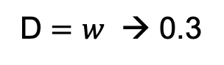
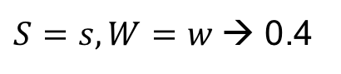
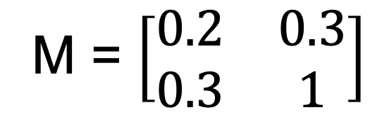
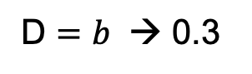
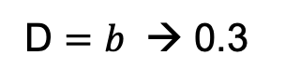
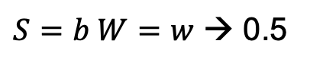
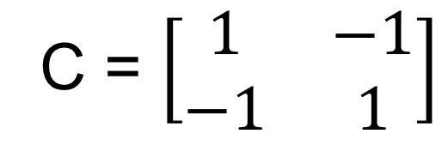
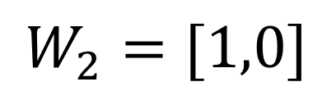
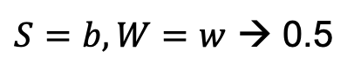
Decision Making Over Combinatorially-Structured Domains
Andrea Martin Tulane University| K. Brent Venable Tulane University and IHCM |
GOALS
Sequential Decision Making
Results
To build a computational model of how human deliberate when confronted with a sequence decisions.
To show a way of representing uncertainty in soft constraint problems.
FCSP
MDFT
Combinatorial
Decision is Made
Implemented both approaches
Test on randomly generated problems.
Consider a setting with two attributes and
We consider a number of variables ranging between 2 and 8 wirh constraint tightness of 20%
Sequential case: deliberation is stopped after 20 iterations on each variable
Non Sequential case: deliberation is stopped after 20n iterations where n is the number of variables.
+
$n$ steps, where at each step $i$ :
We extract the subjective preference of the user on the values in
the domain of $X_{i}$. To do this, we will enforce DAC on the FCSP,
in reverse order w.r.t. $O$ .
2. DFT is applied to $X_{i}$, returning a deliberated assignment for
variable $X_{i}.$
DFT($X_{i}$) = $i$.
3. Finally, DAC is applied to propagate the effect of the assignment
After n steps have been executed, we obtain a final combinatorial decision.
Fuzzy-CSP’s
Soft Constraint
Problems:
Soft constraint:
c=<f,con> where:
Scope: con={X^{c}₁,…, X^{c}_{k}}
Pref Function:
f: D(X^{c}₁)x…xD(X^{c}_{k}) →A
Variables{X₁,…,X_{n}}=X
Domains{D(X₁),…,D(X_{n})}=D
C-semiring <A,+,x,0,1>
T H
Similarity effect on three variables
$S=b, W=b$ → 0.8
M = $\left[\begin{matrix}0.7 & 0.2 \\ 0.4 & 0.8\end{matrix}\right]$
$$Burrito$$
$S=b, W=b$ → 0.8
$S=b, W=w$ → 0.5
0
$$Salad$$
Taste:
$S=b W=w$ → 0.5
Taste:
Entrée
$S=s, W=b$ → 0.2
0
Computational Time:
Seq vs non-seq
Entrée
$S=s, W=b$ → 0.2
Drink
$S=s, W=w$→ 0.4
Drink
$S=s W=w$→ 0.4
Decision 1:
E $=b$ → 0.9
D $=b$ → 0.7
E $=b$ → 0.9
0.7
0.3
0
D $=b$ → 0.7
0.2
E $=s$ → 0.4
D $=w$ → 0.3
Health:
E $=s$ → 0.4
D $=w$ → 0.3
0.3
T H
Health:
Entrée
Drink
Entrée
Drink
M = $\left[\begin{matrix}0.2 & 0.3 \\ 0.3 & 1\end{matrix}\right]$
$$Beer$$
$$Water$$
Attraction effect on three variables
E $=b$ → 0.2
D $=b$ → 0.3
E $=b$ → 0.2
D $=b$ → 0.3
Decision 2:
E $=s$ → 0.8
D $=w$ → 1
E$=s$ → 0.8
D $=w$ → 1
Decision Field Theory
Non- Sequential Decision Making
My Cholesterol levels are high
Attributes: Taste and Health
Eating Options :Burrito, Salad
Drinking Options: Water, Beer
We run the deliberation process only once over the set of candidate options consisting of all complete assignments.
We assume a single decision to be made over a combinatorial structure.
I love how the burrito taste
Percentage of times the decision making procedures return solution
that are not optimal/ optimal in one/ both FCSPs.
I am on a diet I should eat Salad
The burrito smells better
$$V_{1}\left(t\right)={\left[v_{B}\left(t\right),v_{S}\left(t\right) \right]}^{′}$$
$$V\left(t\right)=CMW(t)$$
Conclusions and Future Work
$$P\left(t+1\right)=SP\left(t\right)+V\left(t+1\right)$$
T H
$$C=\left[\begin{aligned}1 \\ −1/3 \\ −1/3 \\ −1/3\end{aligned}\begin{aligned}−\frac{1}{3} \\ 1 \\ −1/3 \\ −1/3\end{aligned}\begin{aligned}−\frac{1}{3} \\ −1/3 \\ 1 \\ −1/3\end{aligned}\begin{aligned}−\frac{1}{3} \\ −1/3 \\ −1/3 \\ 1\end{aligned}\right]$$
C = $\left[\begin{matrix}1 & −1 \\ −1 & 1\end{matrix}\right]$
S = $\left[\begin{matrix}0.94 & −0.001 \\ −0.001 & 0.94\end{matrix}\right]$
$$M_{E}=\left[\begin{aligned}\begin{matrix}0.7 & 0.7 \\ 0.3 & 0.7\end{matrix} \\ \begin{matrix}0.7 & 1 \\ 0.4 & 0.8\end{matrix}\end{aligned}\right]$$
We have presented an approach for modeling deliberation on combinatorially structured domains.
We show that decomposing decision making into a sequence of deliberation steps performed with DFT is a feasible approach to tackling this problem.
T H
$$Burrito$$
$$W_{1}=[0,1]$$
M = $\left[\begin{matrix}0.7 & 0.2 \\ 0.4 & 0.8\end{matrix}\right]$
$$Salad$$
$$W_{2}=[1,0]$$

